Slide 1
Rural Ontario’s Population Growth During COVID-19, Fad or Trend
October 2021
The views and forecasts presented in this document are not necessarily those of the government of Ontario

Slide 2
Purpose and definitions
The pandemic has led to an acceleration in population growth outside large urban centers.
House price appreciation has accelerated to multi-decade highs in many Ontario rural communities and smaller urban centers since the spring of 2020.
This presentation provides and overview of factors responsible for the rise in non-major urban house prices.
Definitions:
Non-major urban (NMU) area: All Ontario less Toronto and Ottawa CMA.
Rural housing regions: Provided by the Canadian Real Estate Association and are defined by local real estate boards.

Slide 3
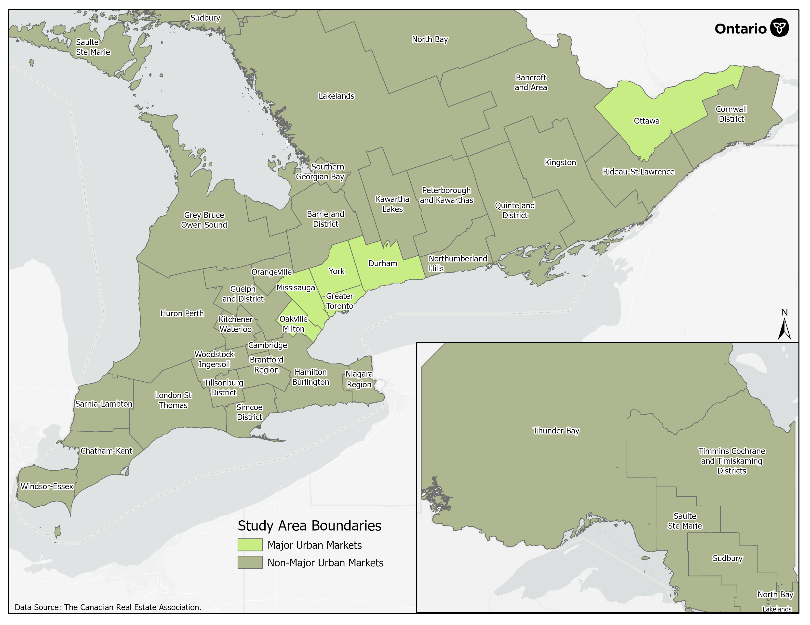
The Focus of this Analysis are Non-Major Urban (NMU) Housing Markets

Slide 4
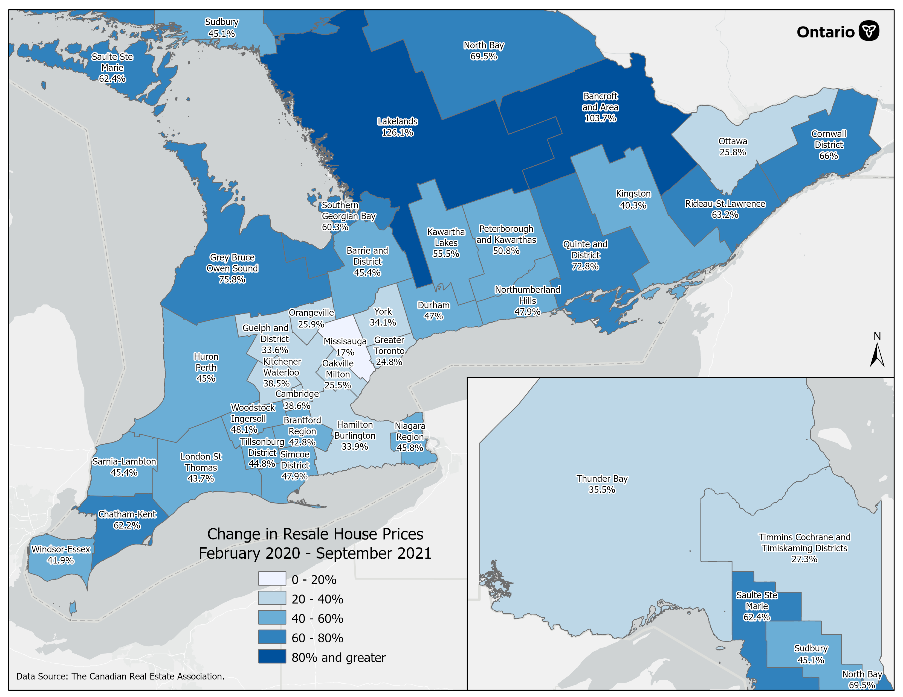
House Resale Price Changes by Real Estate Board, Feb 2020 – Sep 2021

Slide 5
Housing Market Cycles: Major Vs. Non- Major Urban (NMU) Centers
NMU

Slide 6
Ontario’s NMU Population Growth is Accelerating
NMU population growth began to accelerate in 2016 as Toronto housing affordability started erode more quickly.
Toronto resale house price growth accelerated from 9.5% in 2015 to 17.5% in 2016, representing the largest one-year increase in house price appreciation in three decades.

Slide 7
Drivers of Ontario NMU Population Growth
Statistic Canada under-estimating NMU population growth in 2020

Slide 8
Ontario’s NMU Population Adjusted to Reflect Impact of Pandemic
Using the estimated relationship between NMU population growth and house prices, we can calculate an upper bound for population growth given the evolution of house prices in 2020.

Slide 9
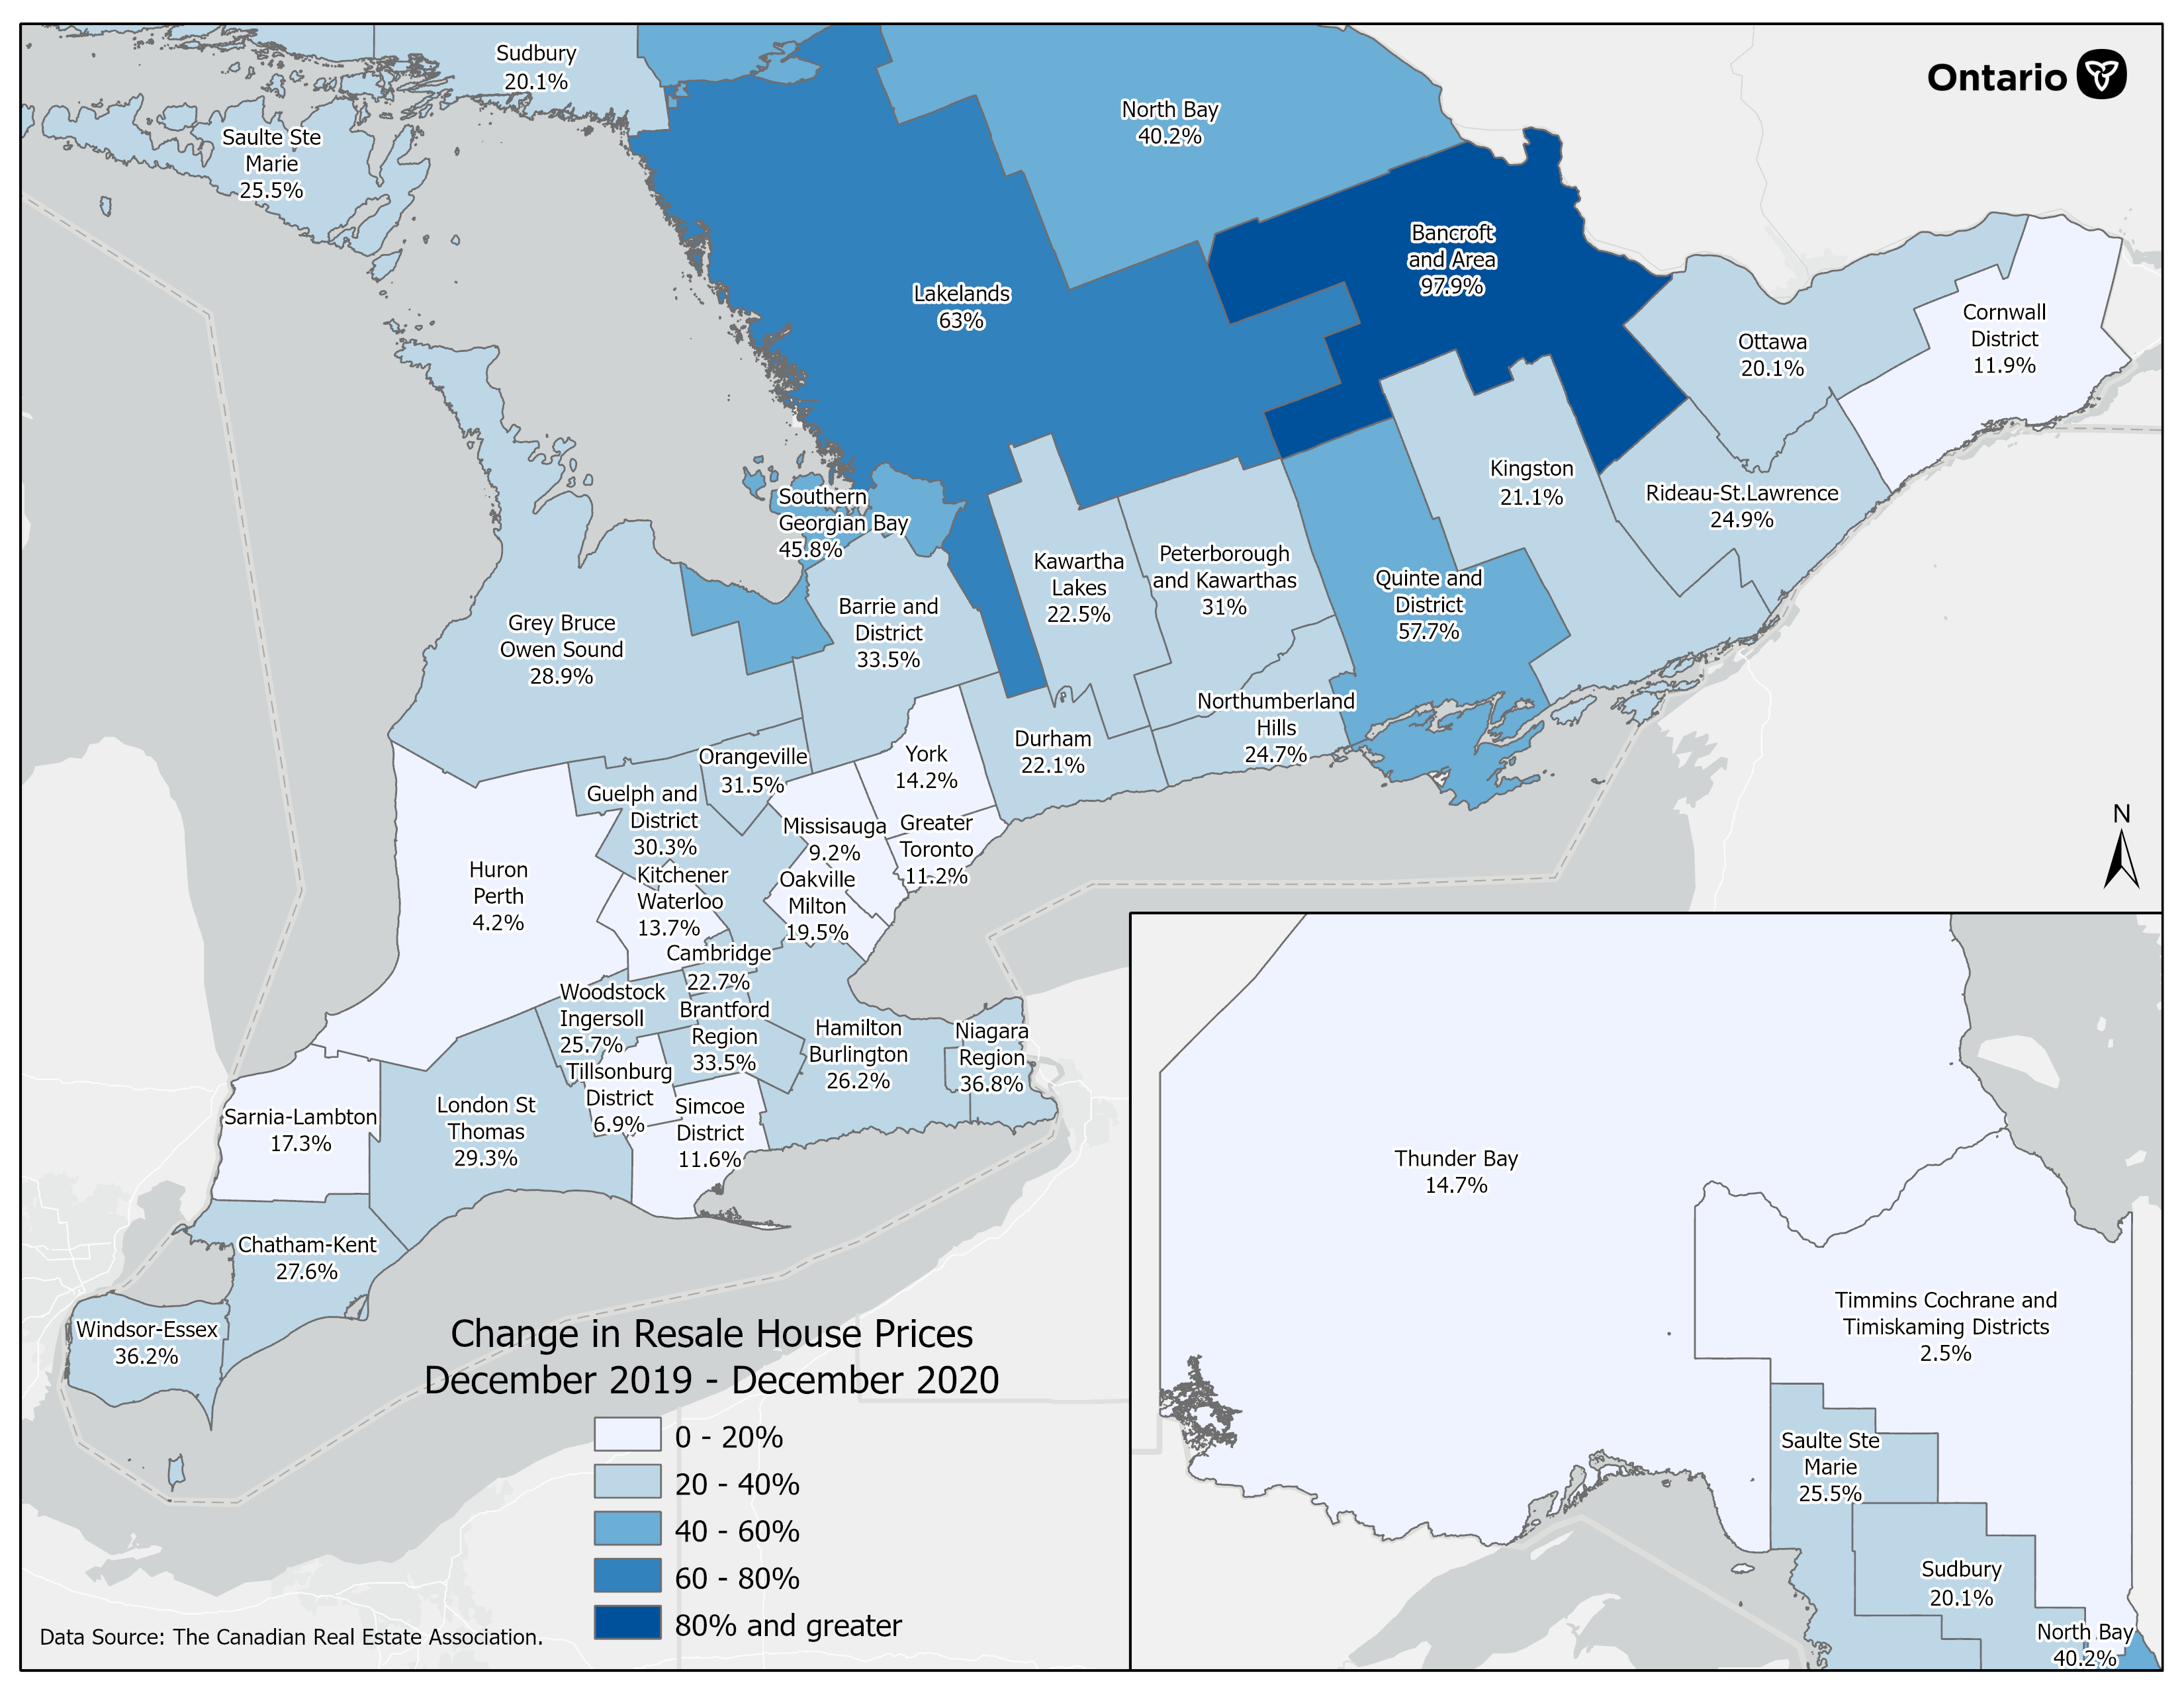
House Resale Price Changes by Real Estate Board, Dec 2019 – Dec 2020

Slide 10
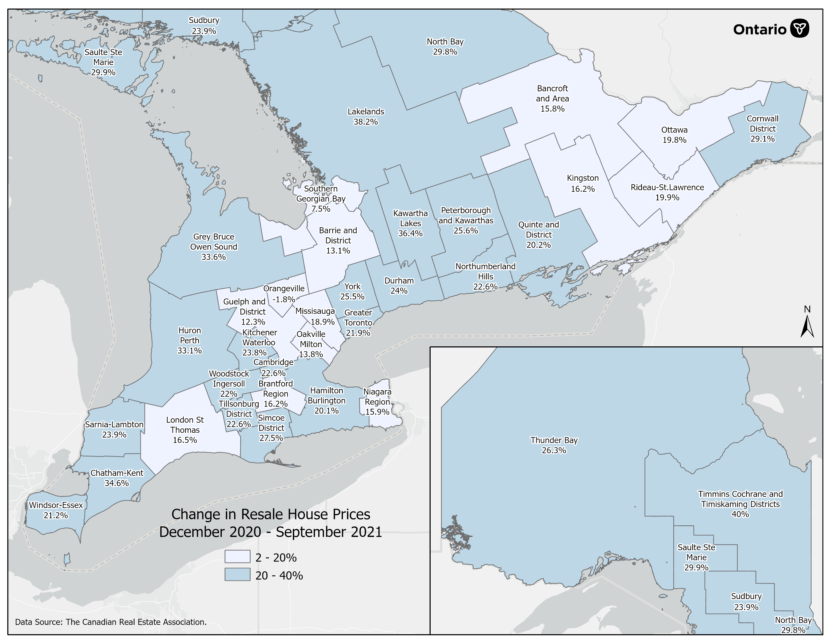
House Resale Price Changes by Real Estate Board, Dec 2020 – Sep 2021

Slide 11
Will Post Pandemic Population Growth Revert Back to Trend?
Some of the recent increase in NMU population growth likely brought forward by pandemic.
As pandemic fades, some give back is likely as benefits of urban living reassert themselves.
After a period of adjustments, and if pre-pandemic trends reassert themselves, NMU population growth could return to about 1.0% per year – still faster than at any time over the last 4-decades prior to 2016.
This does not account for lingering impacts of pandemic, which could see more households relocate to NMU areas.

Slide 12
NMU Housing Market Reaction to Stronger Demand

Slide 13
Monthly Number of Building Permits in Rural Ontario, by type
Source: OMAFRA calculations adapted from Statistics Canada. Table 34-10-0066-01 Building permits, by type of structure and type of work
  The number of residential permits decreased by 289 or -7.4% from July to August 2021, and is 4.9% lower than the same month prior to the COVID-19 pandemic (August 2019).

Slide 14
Summary
Population growth has accelerated outside of Ontario’s large urban centers.
Changes in population are estimated to be the most important driver of house prices in areas of the province outside of large urban centers.
House price appreciation in these regions has accelerated, eroding housing affordability.
Population growth is expected to ease in these regions but remain elevated by recent historical standards.
Residential construction was not increasing as quickly as demand prior to the pandemic, highlighting pressure on house prices and affordability may persist for some time.

