Slide 1

Household Income vs
Housing Prices

Slide 3

Please Note
Every house purchase is different. For simplicity's sake these numbers are all based on the 30% affordability, target but don't take into account housing related costs like property taxes, utilities, and insurance (which by CMHC standards should be included). These numbers also assume closing costs are similar to down payment costs. It should also be noted 44% is the maximum ratio lenders can use for total housing costs (including taxes, heating, utilities) against annual household income.
This is all to say every buyer has a different situation and these numbers should be used as a general guideline which represents the average in most cases.

Slide 4
Avg. Sale Price in Huron County
July 2016: $265,000
July 2020: $474,000
May 2021: $616,000

Slide 5
Requires household earning:
July 2016: $31.8/hr for 37.5/week
July 2020: $56.8/hr for 37.5/week
May 2021: $73.9/hr for 37.5/week

Slide 6
Actual Avg. Huron County
Household Income:
2016: $65,944 or $33.8/hr
2020: $72,808 or $37.3/hr

Slide 7
Yr Actual Needed
’16 $33.8/hr $31.8/hr + 2.0
’20 $37.3/hr $56.8/hr - 19.5
’21 ~$38.2/hr $73.9/hr - 35.7

Slide 8
Source: MLS & 2016 Statistics Canada Census of Population

Slide 9
Cashier
Food counter attendants
Retail salesperson
General farm worker
Construction labourers
Truck drivers
Nurse aids & health care attendants
Registered nurses
Teachers

Slide 10
Cashier
Food counter attendants
Retail salesperson
General farm worker
Construction labourers
Truck drivers
Nurse aids & health care attendants
Registered nurses ($34/hr)
Teachers ($40/hr)

Slide 12
Occupation Name | Skill Level | # of Postings | Median Hourly Wage 2019
Professional occupations in nursing | NOC Skill Level A | 71 | $ 35.48
Retail salespersons | NOC Skill Level C | 31 | $ 14.63
Other technical occupations in health care | NOC Skill Level B | 30 | $ 27.74
Agriculture and horticulture workers | NOC Skill Level C | 30 | $ 15.70
Labourers in processing, manufacturing and utilities | NOC Skill Level D | 30 | $ 18.51
Motor vehicle and transit drivers | NOC Skill Level C | 28 | $ 16.82
Customer and information services representatives | NOC Skill Level C | 25 | $ 17.57
Managers in food service and accommodation | NOC Skill Level A | 25 | $ 15.26
Office administrative assistants - general, legal and medical | NOC Skill Level B | 22 | $ 19.95
Home care providers and educational support occupations | NOC Skill Level C | 22 | $ 17.63
Source: Connect2jobs.ca Job Demand Report, EMSI Analyst
Notes:
Top 10 currently in-demand occupations in Huron County, according to current job postings.
Matched with 2019 median hourly wages, sourced from EMSI analyst.

Slide 14
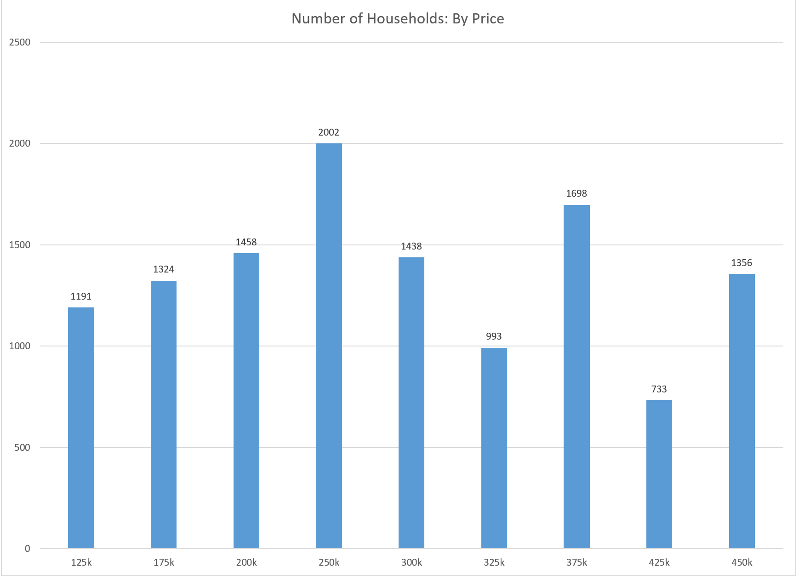

Slide 15
Avg. Sale Price by 2016

Slide 16
Avg. Sale Price by 2020

Slide 17
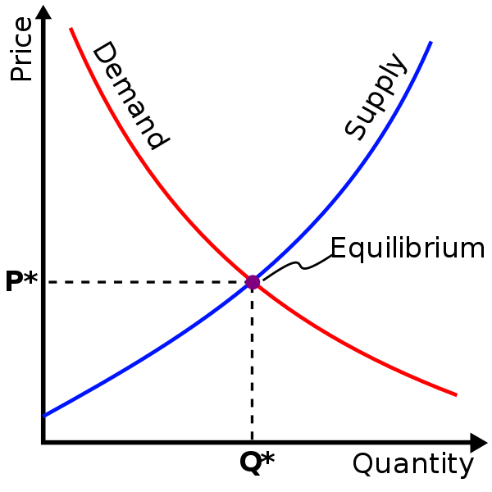
Low demand, high supply = low prices
Low demand, low supply = medium prices
High demand, low supply = high prices
High demand, high supply = medium prices

Slide 18
Housing Demand & Supply Factors
Strong economy & housing market across Canada
Near Greater Toronto Area (GTA)
Pandemic + Work from Home
Low unemployment
Low interest rates
Canadian Immigration levels

Slide 19
Primary tools for communities
Land development policies
Add additional supports and social housing
Financial incentives
Build more houses

Slide 20
Primary tools for communities
Land development policies
passive approach
Add additional supports and social housing
Financial incentives
Build more houses

Slide 21
Primary tools for communities
Land development policies
Add additional supports and social housing
money comes from tax base (income or property)
Financial incentives
Build more houses

Slide 22
Primary tools for communities
Land development policies
Add additional supports and social housing
Financial incentives
Money comes from tax base (income or property)
Build more houses

Slide 23

Primary tools for communities
Land development policies
Add additional supports and social housing
Financial incentives
Build more houses

Slide 24
Key Takeaways:
If you owned a house that appreciated in value you are probably doing okay
Likely creating a large divide between those that owned a house 5-10 years ago and those that didn’t
The trend is alarming for the “average” household
A good job isn’t enough anymore to promise a good home
Need more housing less then 400k and/or $1500/mo
Requires bold action or accepting reality, no half measures

Slide 25
Key Takeaways:
If you owned a house that appreciated in value you are probably doing okay
Likely creating a large divide between those that owned a house 5-10 years ago and those that didn’t
The trend is alarming for the “average” household
A good job isn’t enough anymore to promise a good home
Need more housing less then 400k and/or $1500/mo
Requires bold action or accepting reality, no half measures

Slide 26
Key Takeaways:
If you owned a house that appreciated in value you are probably doing okay
Likely creating a large divide between those that owned a house 5-10 years ago and those that didn’t
The trend is alarming for the “average” household
A good job isn’t enough anymore to promise a good home
Need more housing less then 400k and/or $1500/mo
Requires bold action or accepting reality, no half measures

Slide 27
Key Takeaways:
If you owned a house that appreciated in value you are probably doing okay
Likely creating a large divide between those that owned a house 5-10 years ago and those that didn’t
The trend is alarming for the “average” household
A good job isn’t enough anymore to promise a good home
Need more housing less then 400k and/or $1500/mo
Requires bold action or accepting reality, no half measures

Slide 28
Key Takeaways:
If you owned a house that appreciated in value you are probably doing okay
Likely creating a large divide between those that owned a house 5-10 years ago and those that didn’t
The trend is alarming for the “average” household
A good job isn’t enough anymore to promise a good home
Need more housing less then 400k and/or $1500/mo
Requires bold action or accepting reality, no half measures

Slide 29
Key Takeaways:
If you owned a house that appreciated in value you are probably doing okay
Likely creating a large divide between those that owned a house 5-10 years ago and those that didn’t
The trend is alarming for the “average” household
A good job isn’t enough anymore to promise a good home
Need more housing less then 400k and/or $1500/mo
Requires bold action or accepting reality, no half measures

Slide 30
Key Takeaways:
If you owned a house that appreciated in value you are probably doing okay
Likely creating a large divide between those that owned a house 5-10 years ago and those that didn’t
The trend is alarming for the “average” household
A good job isn’t enough anymore to promise a good home
Need more housing less then 400k and/or $1500/mo
Requires bold action or accepting reality, no half measures

